Slide 1
Project
By:- Rituraj Sharma

Slide 2

Introduction
YouTube is the world’s largest video-sharing platform and a leading social media service, providing a space for billions of users to share, view, and engage with video content. Founded in February 2005 by Steve Chen, Chad Hurley, and Jawed Karim, the platform was created to simplify the sharing of videos online. Its first video, "Me at the Zoo," uploaded by Jawed Karim, symbolized the platform's humble beginnings. In November 2006, Google acquired YouTube for $1.65 billion in stock, recognizing its immense potential. Since then, YouTube has grown exponentially to become a cornerstone of digital media, culture, and commerce

Slide 3
Steps done in the dataset
01
02
03
04
05
Data
Collection
Data cleaning
and preprocessing
Exploratory Data Analysis (EDA)
Insights
and Visualization
Conclusion

Slide 4


Queries
Top 5 Channel Category on youtube
Top 10 Channel Types on Youtube
Subscribers according to the video views
Top 10 Subscribed country on Youtube
What is the highest Monthly earning channel type
What is the total of subscribers by category and country
What is the gross territary education enrolment % vs subscribers
What is the average rate by channel type
What is the average ratio of subscribers by created year and channel type
What is the subscribers growth overtime
What is the trend of highest yearly earnings by created year and country
what is the highest monthly earnings by category
what is the average subscribers for last 30 days

Slide 5
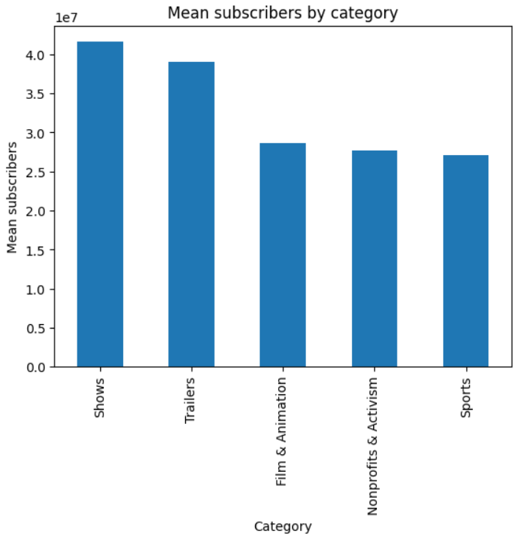
Q.1 Top 5 Channel Categories on youtube
The top 5 channel categories with the highest average subscriber count are likely to be the most popular and engaging categories on YouTube. These categories may attract more viewers and generate more revenue for creators

Slide 6
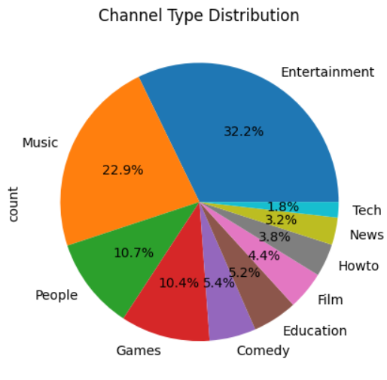
Q.2 Top 10 Channel Types on YouTube
Entertainment and Music channels dominate the YouTube landscape, indicating a high demand for entertainment content on the platform.

Slide 7
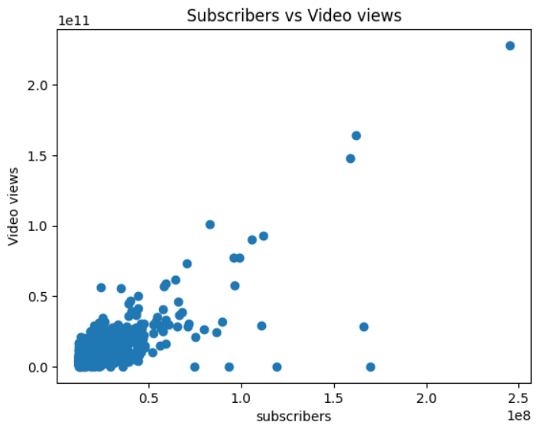
Q.3 Subscribers according to the Video Views:
There is a positive correlation between subscribers and video views, suggesting that channels with more subscribers tend to have higher video views. This highlights the importance of building a subscriber base to increase video visibility and reach.

Slide 8
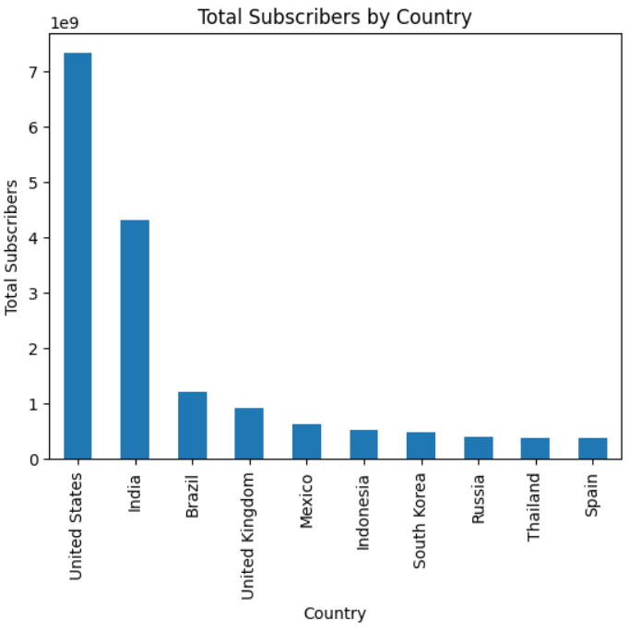
Q.4 Top 10 Subscribed Country on YouTube
The United States and India have the highest total subscriber count on YouTube, reflecting the large user base and popularity of the platform in these countries

Slide 9
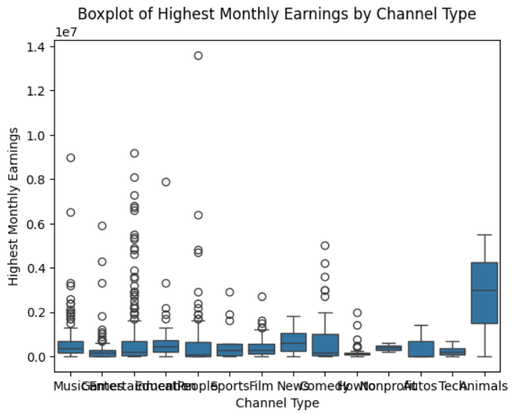
Q.5 Highest Monthly Earning Channel Type
Entertainment channels tend to have the highest monthly earnings potential on YouTube, indicating that creating engaging and entertaining content can be a lucrative strategy for creators.

Slide 10
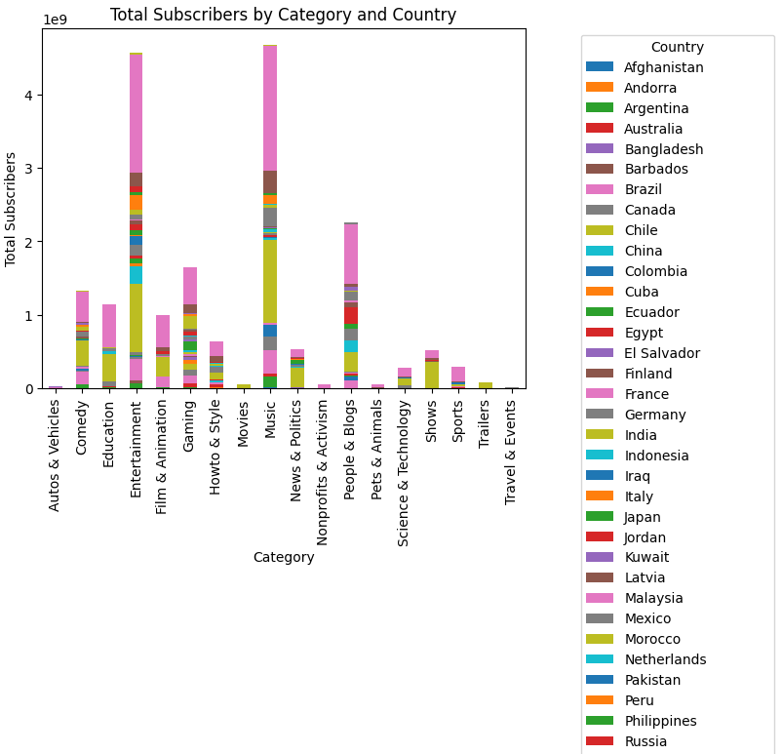
Q.6 Total Subscribers by Category and Country:
The distribution of subscribers across categories and countries reveals insights into the popularity of different content types in various regions. This information can be valuable for creators and marketers targeting specific audiences

Slide 11
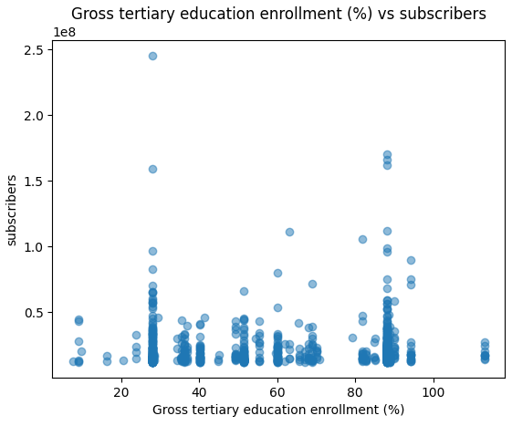
Q.7 Gross Tertiary Education Enrollment (%) vs. Subscribers
There may be a relationship between a country's education level and YouTube subscriber count, suggesting that higher education levels could correlate with increased YouTube usage.

Slide 12
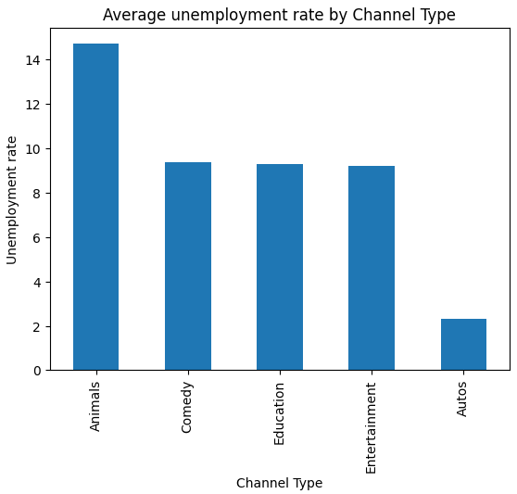
Q.8 Average Unemployment Rate by Channel Type
The unemployment rate may vary across different channel types, indicating potential economic factors influencing creator activity on YouTube.

Slide 13
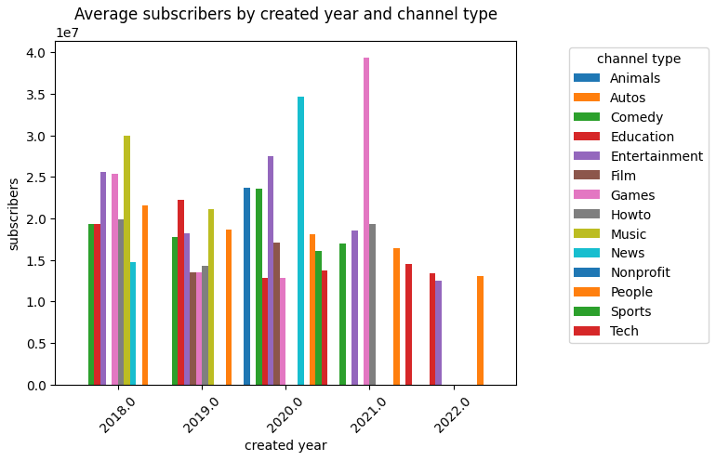
Q.9 Average Subscribers by Created Year and Channel Type
The average subscriber count for different channel types may have changed over time, reflecting shifts in audience preferences and content creation trends

Slide 14
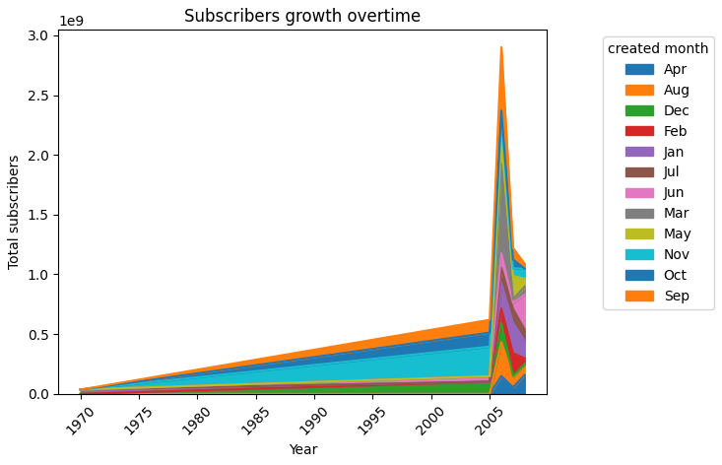
Q.10 Subscribers Growth Over Time
YouTube has experienced significant subscriber growth over the years, particularly in recent times, indicating the platform's increasing popularity and reach.

Slide 15
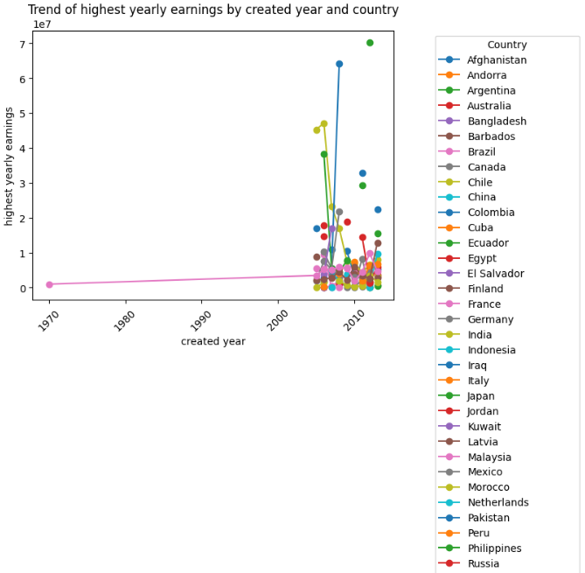
Q.11 Trend of Highest Yearly Earnings by Created Year and Country
The trend of highest yearly earnings for different countries may reveal insights into the monetization potential of YouTube in various regions and how it has evolved over time

Slide 16
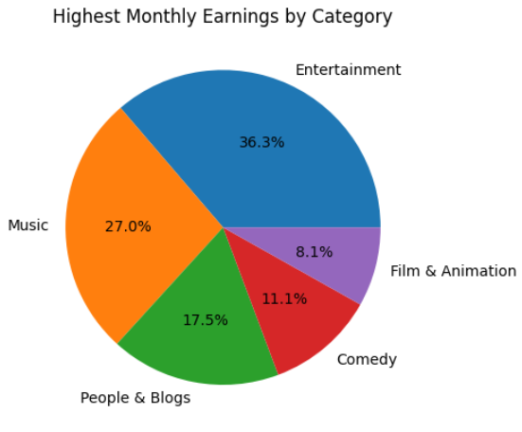
Q.12 Highest Monthly Earnings by Category
The categories with the highest monthly earnings potential are Entertainment,Music and People & Blogs likely to be the most competitive and lucrative niches on YouTube.

Slide 17
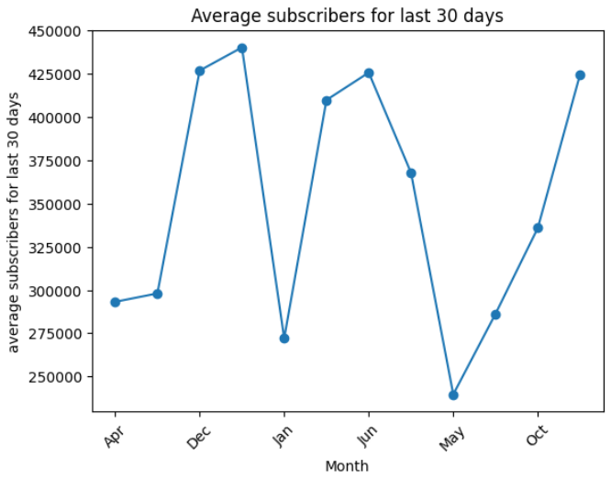
Q.13 Average Subscribers for Last 30 Days:
The average subscriber growth rate for the last 30 days can provide insights into the current popularity and engagement levels of different channels.

Slide 18
Conclusion
The YouTube Statistics dataset reveals valuable insights into the landscape of YouTube channels, content creation, and audience engagement. The analysis indicates that the platform is dominated by Entertainment and Music channels, with a strong correlation between subscriber count and video views. The United States and India have the largest subscriber bases, highlighting the global reach of YouTube.
While Entertainment channels show high earning potential, the data suggests that a variety of factors, including category, country, and creation year, can influence channel success and subscriber growth. Furthermore, there are potential correlations between education levels and YouTube usage, as well as economic factors and creator activity.
Overall, the dataset paints a picture of a dynamic and evolving platform where creators and audiences engage with diverse content, and where success is influenced by a complex interplay of factors. This information can be valuable for content creators, marketers, and researchers seeking to understand and leverage the power of YouTube.

Slide 19

THANK YOU

